Slide 1
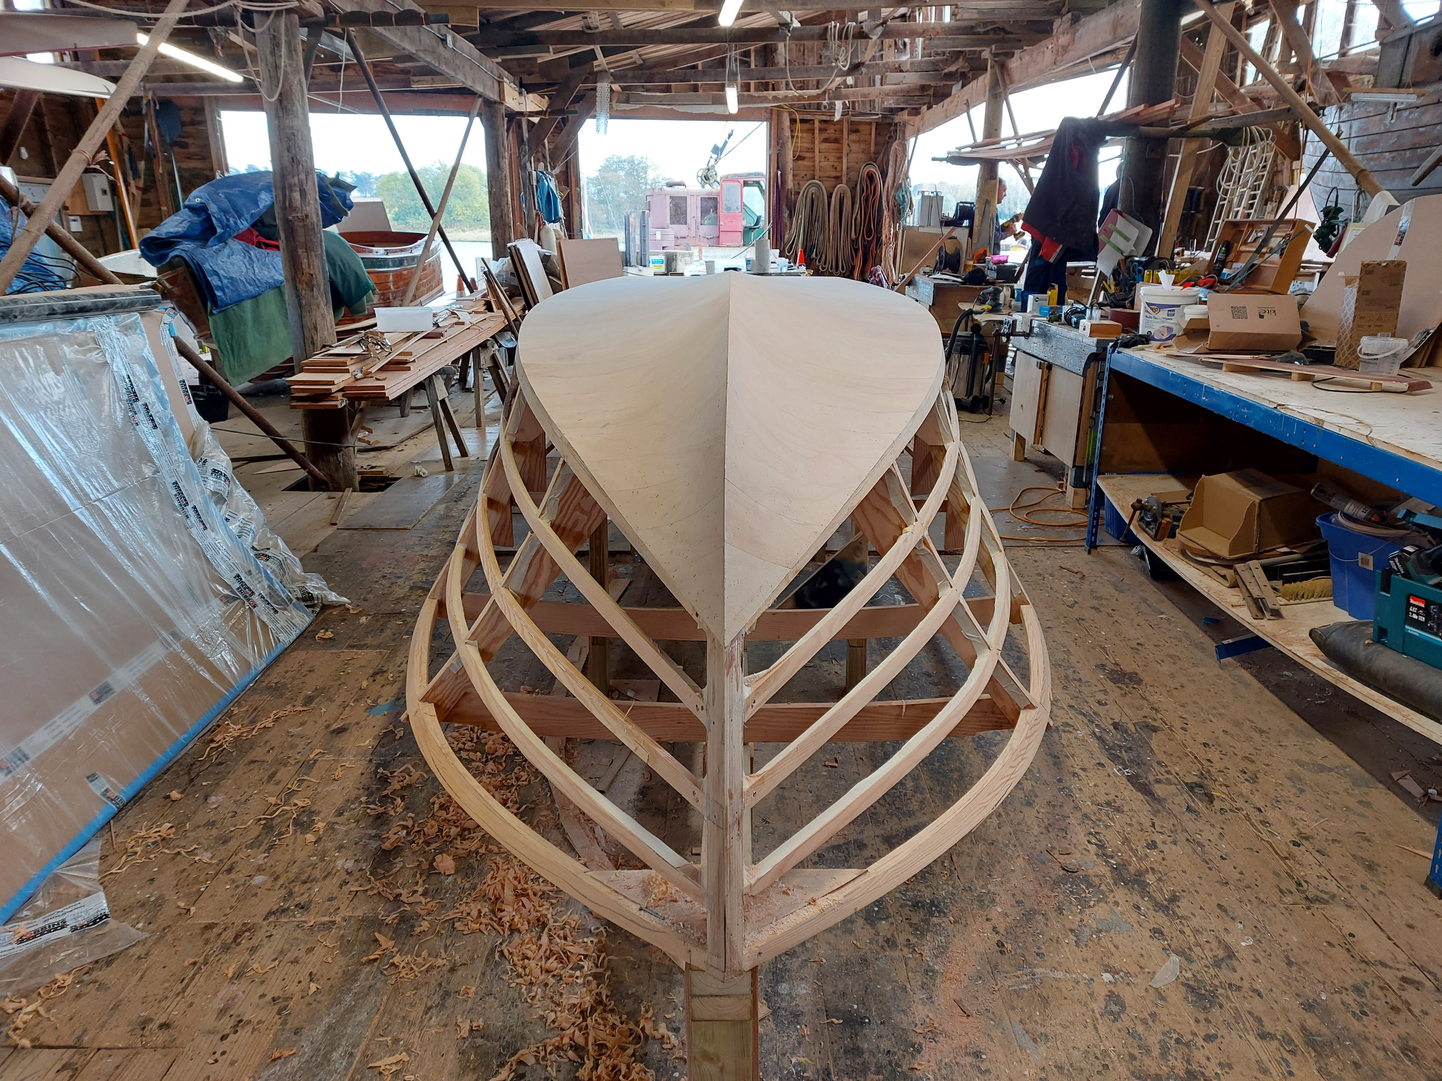
Barrelback 19 with steamed stringers (fore and aft timbers)

Slide 2
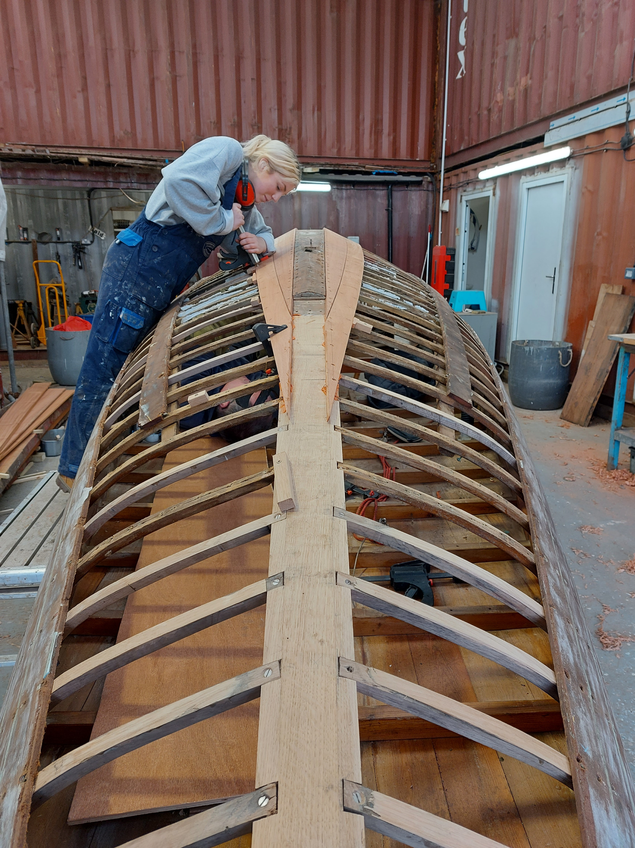
Steamed ribs in a Bembridge Redwing during re-planking

Slide 3
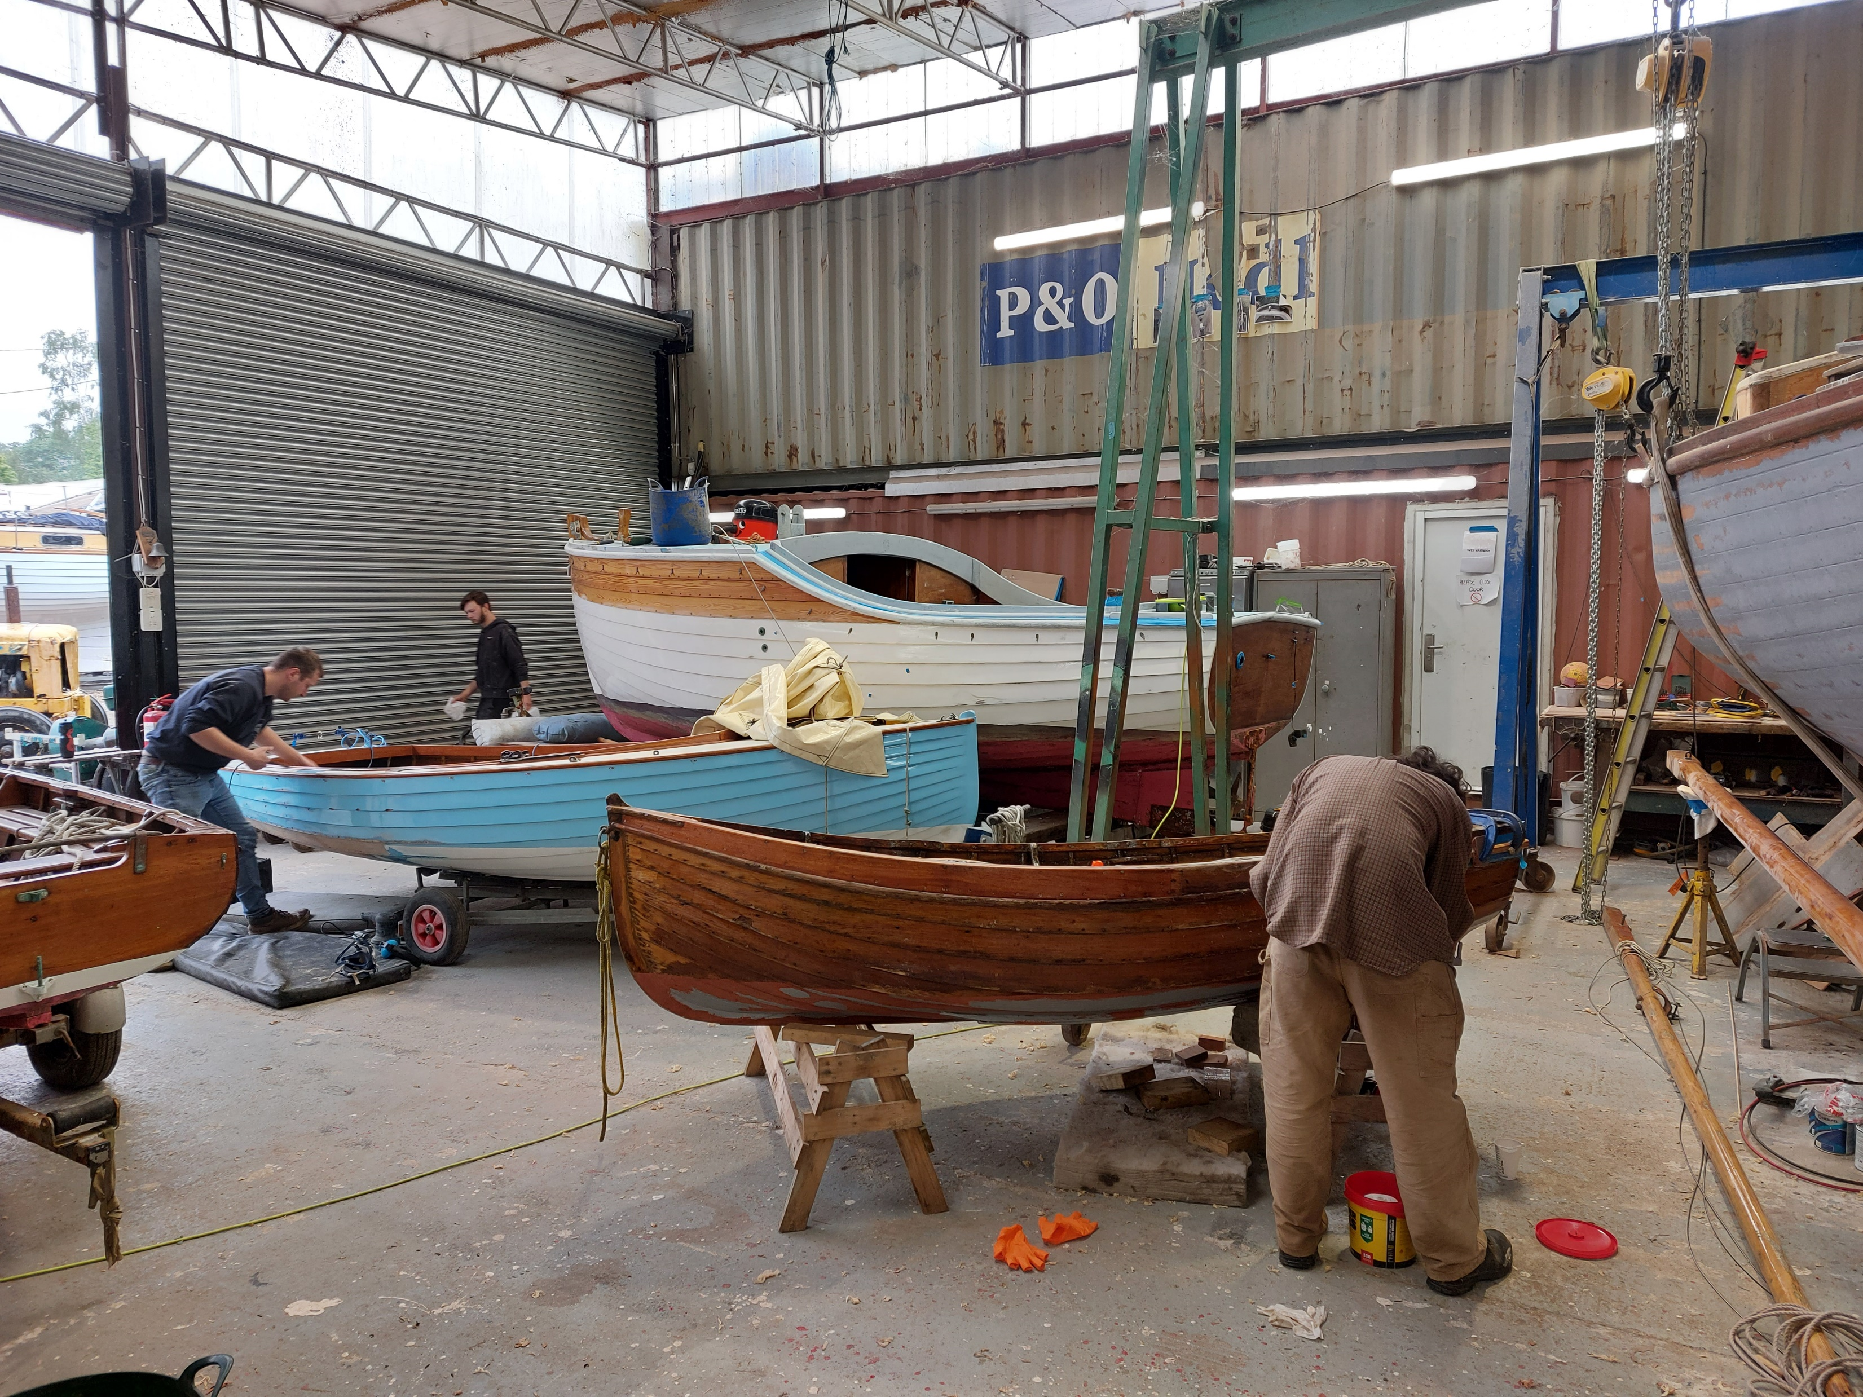
A range of clinker and carvel-built boats all with steamed planking

Slide 4
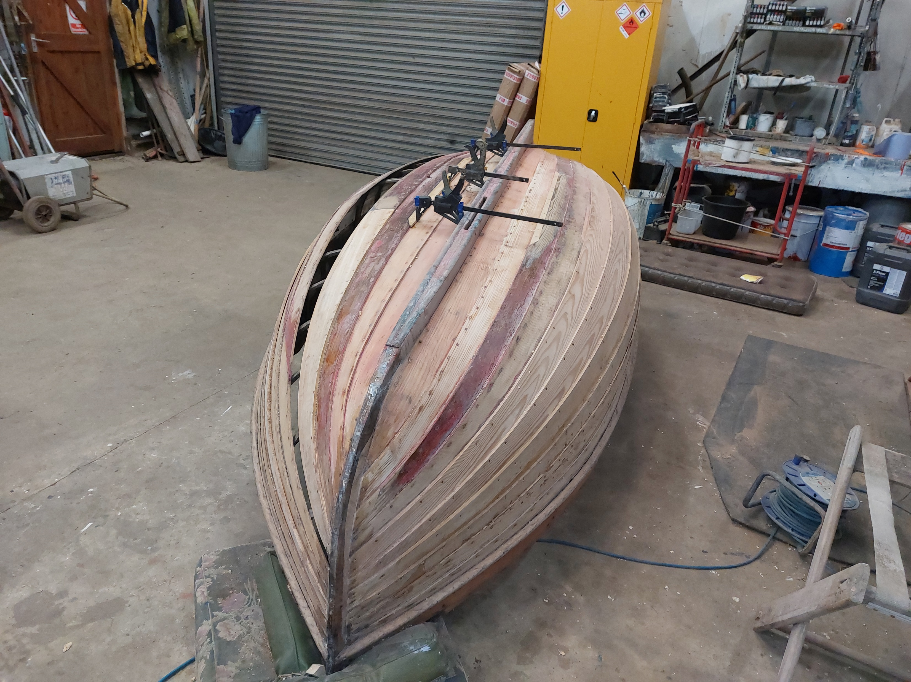
Replacement planks being steamed into an Orford Dabchick clinker dinghy

Slide 5
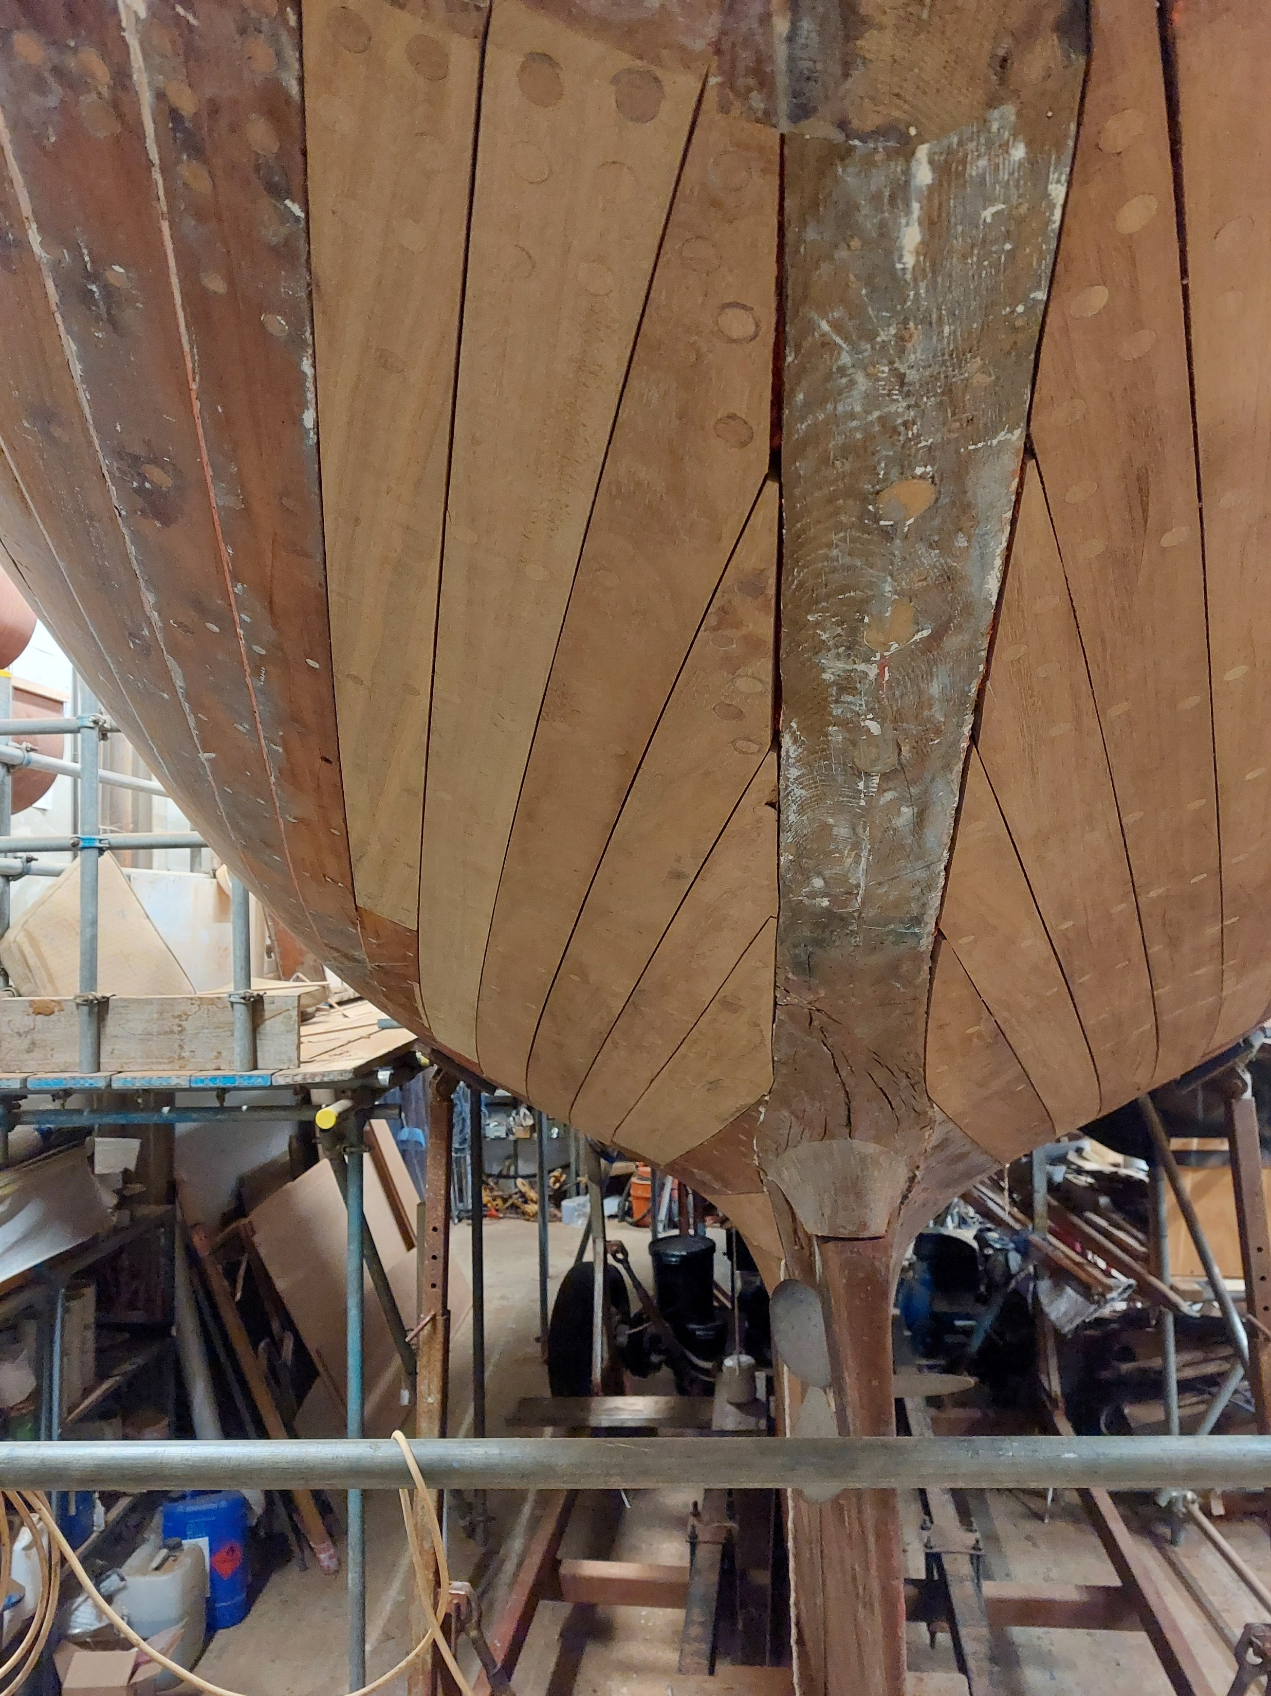
1” thick planking steamed to bend and twist for re-planking a 34ft Buchanan Saxon Class yacht

Slide 6
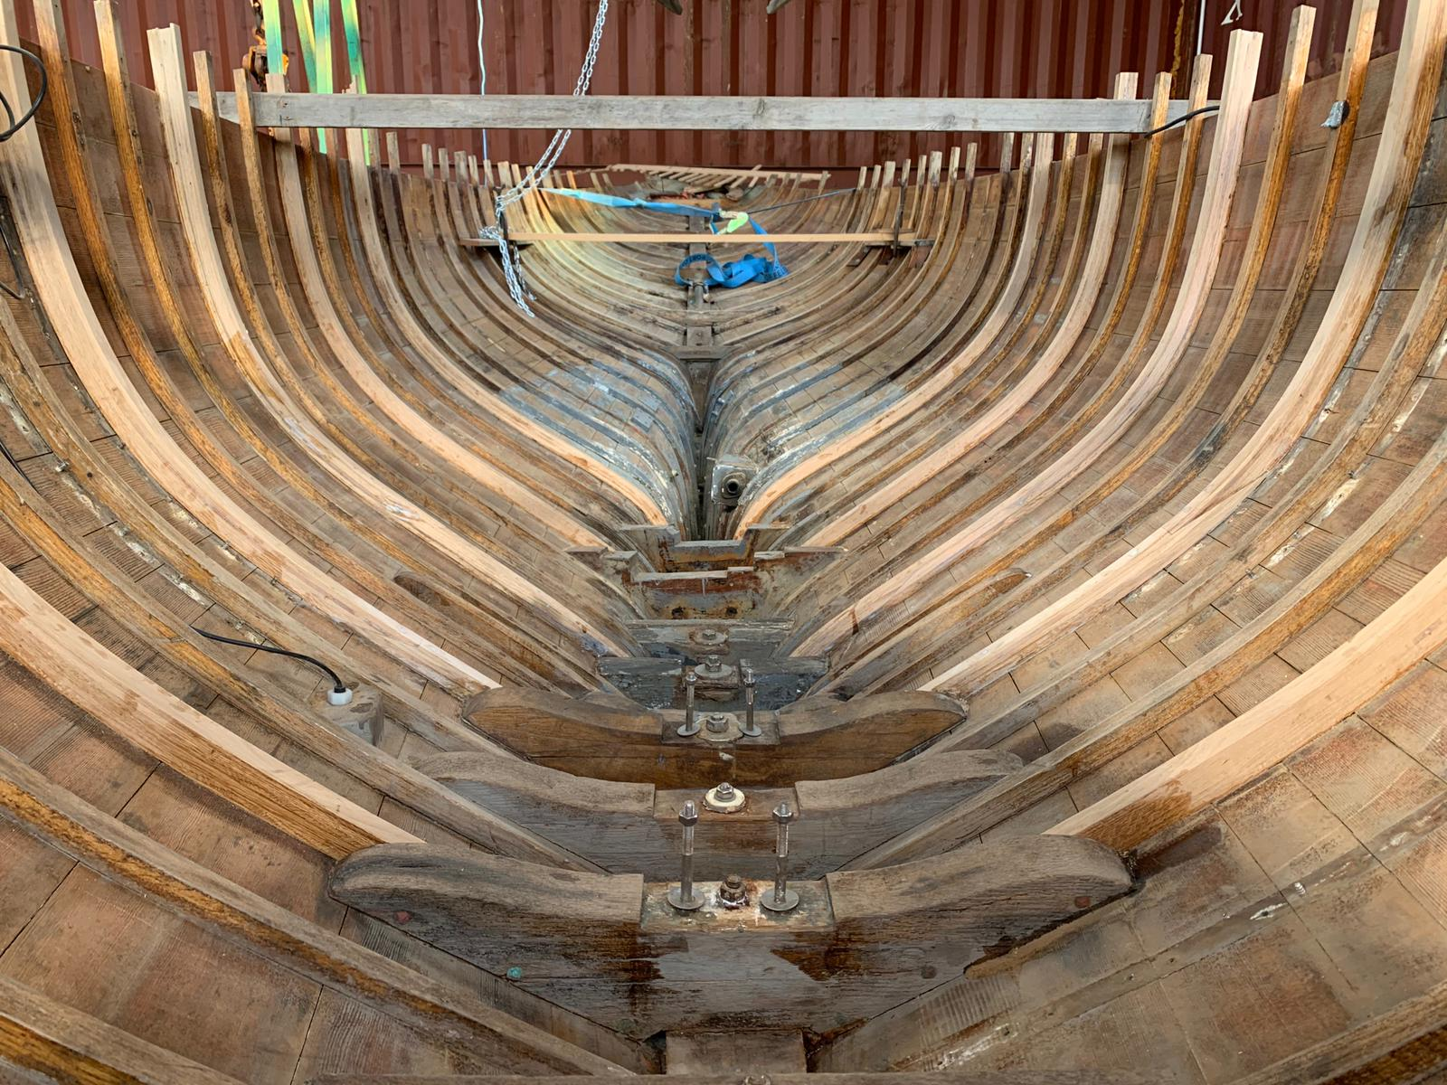

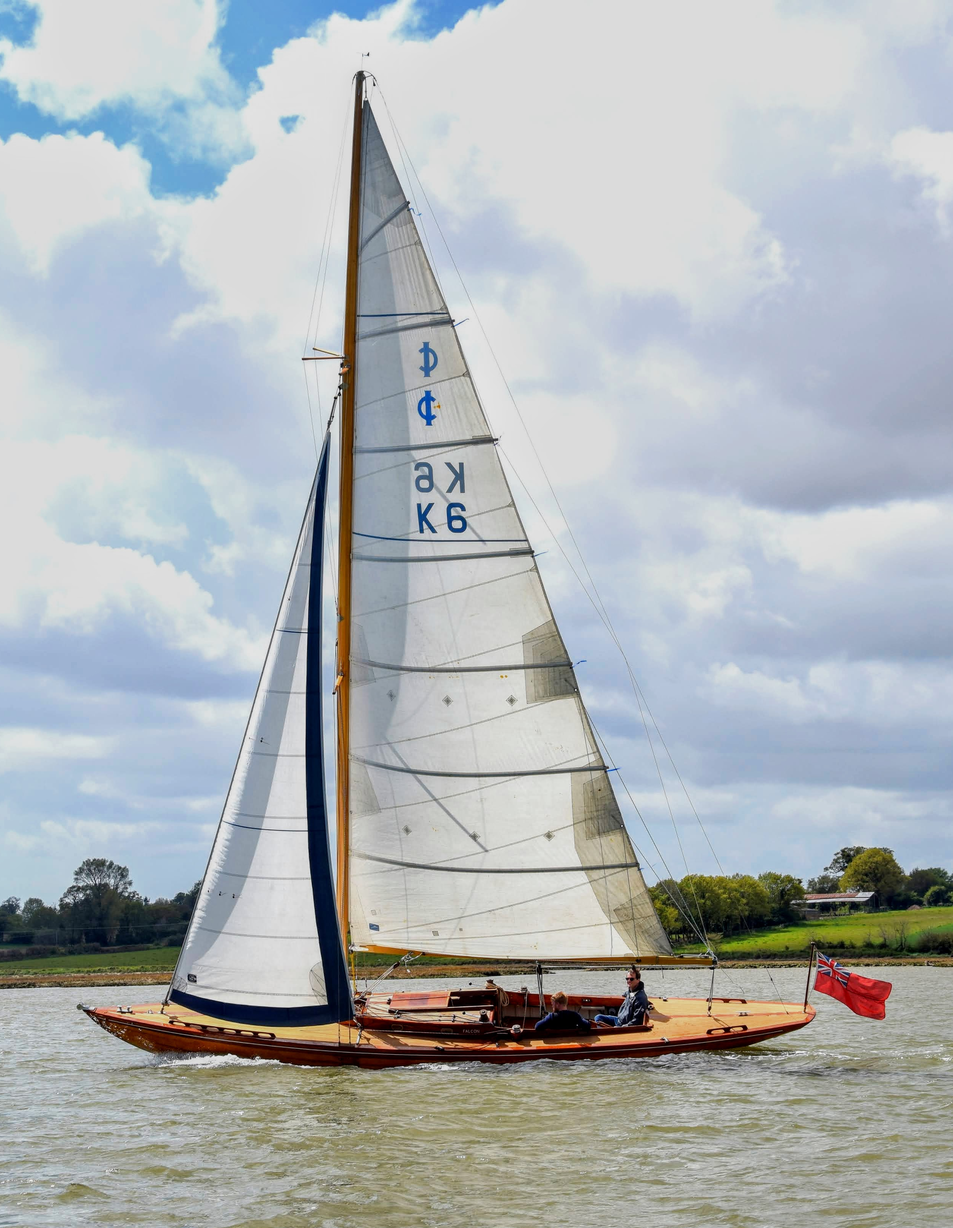
During restoration with new ribs steamed in and out sailing – International One Design

Slide 7
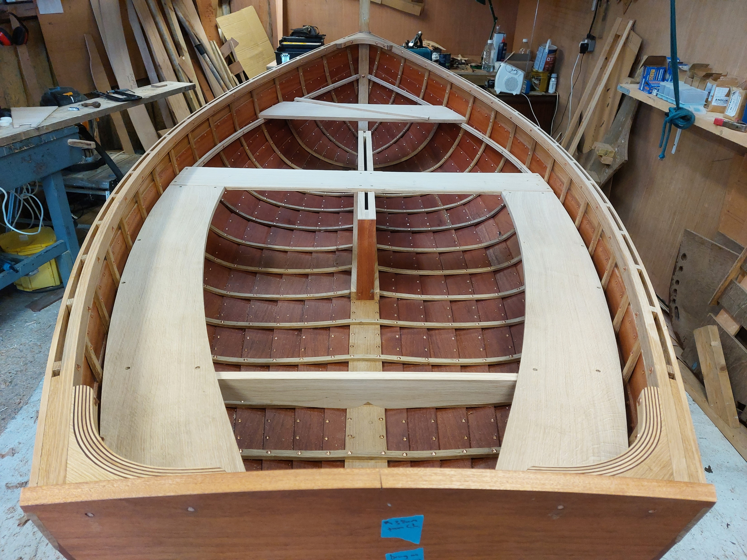
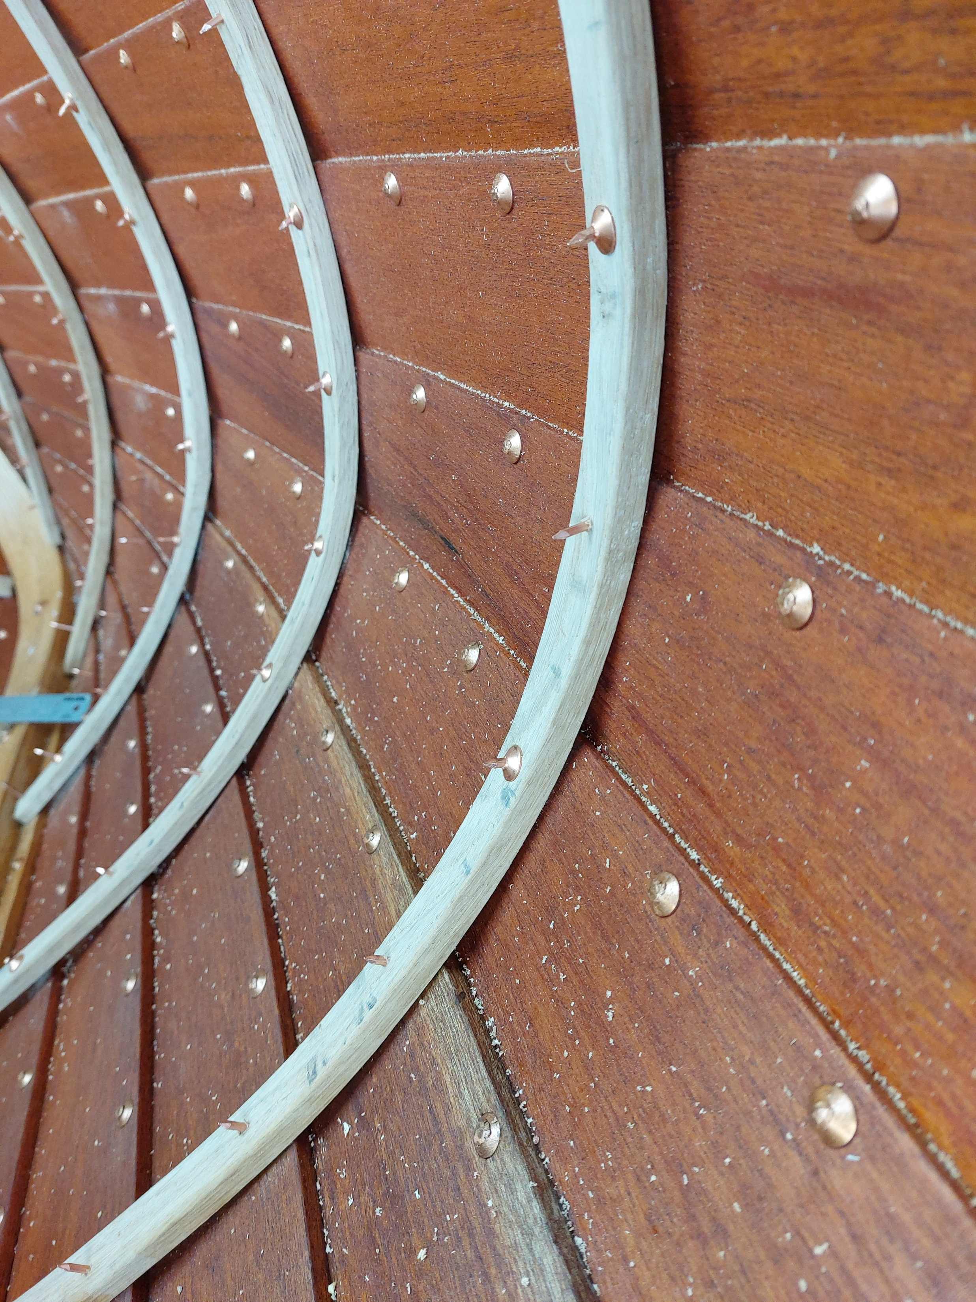
Ribs in the Everson 11 – Next door on the WBTA stand

Slide 8
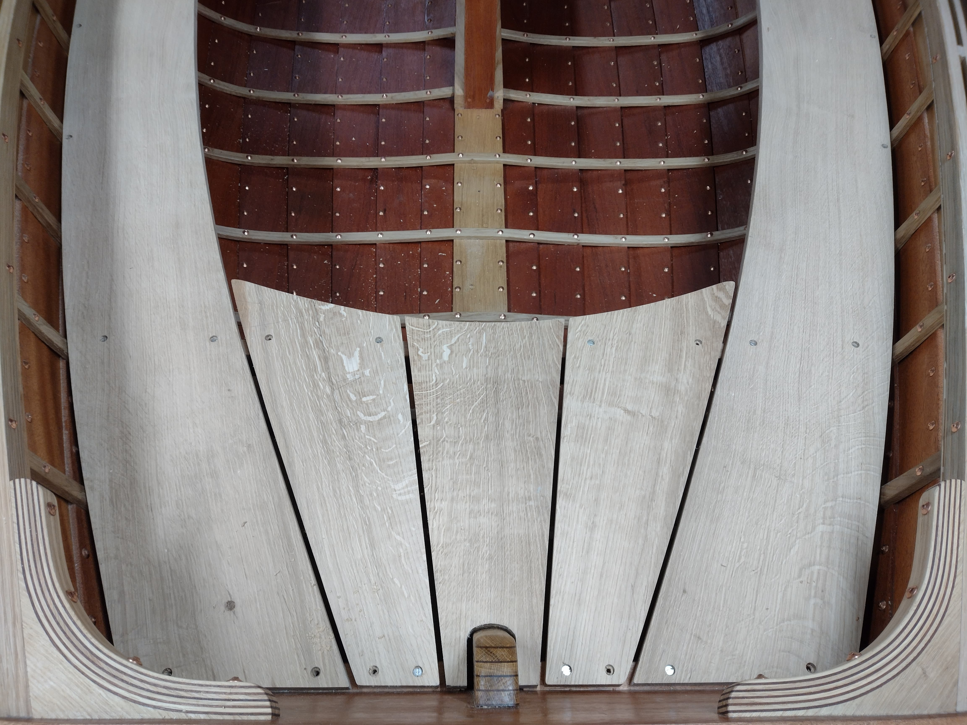
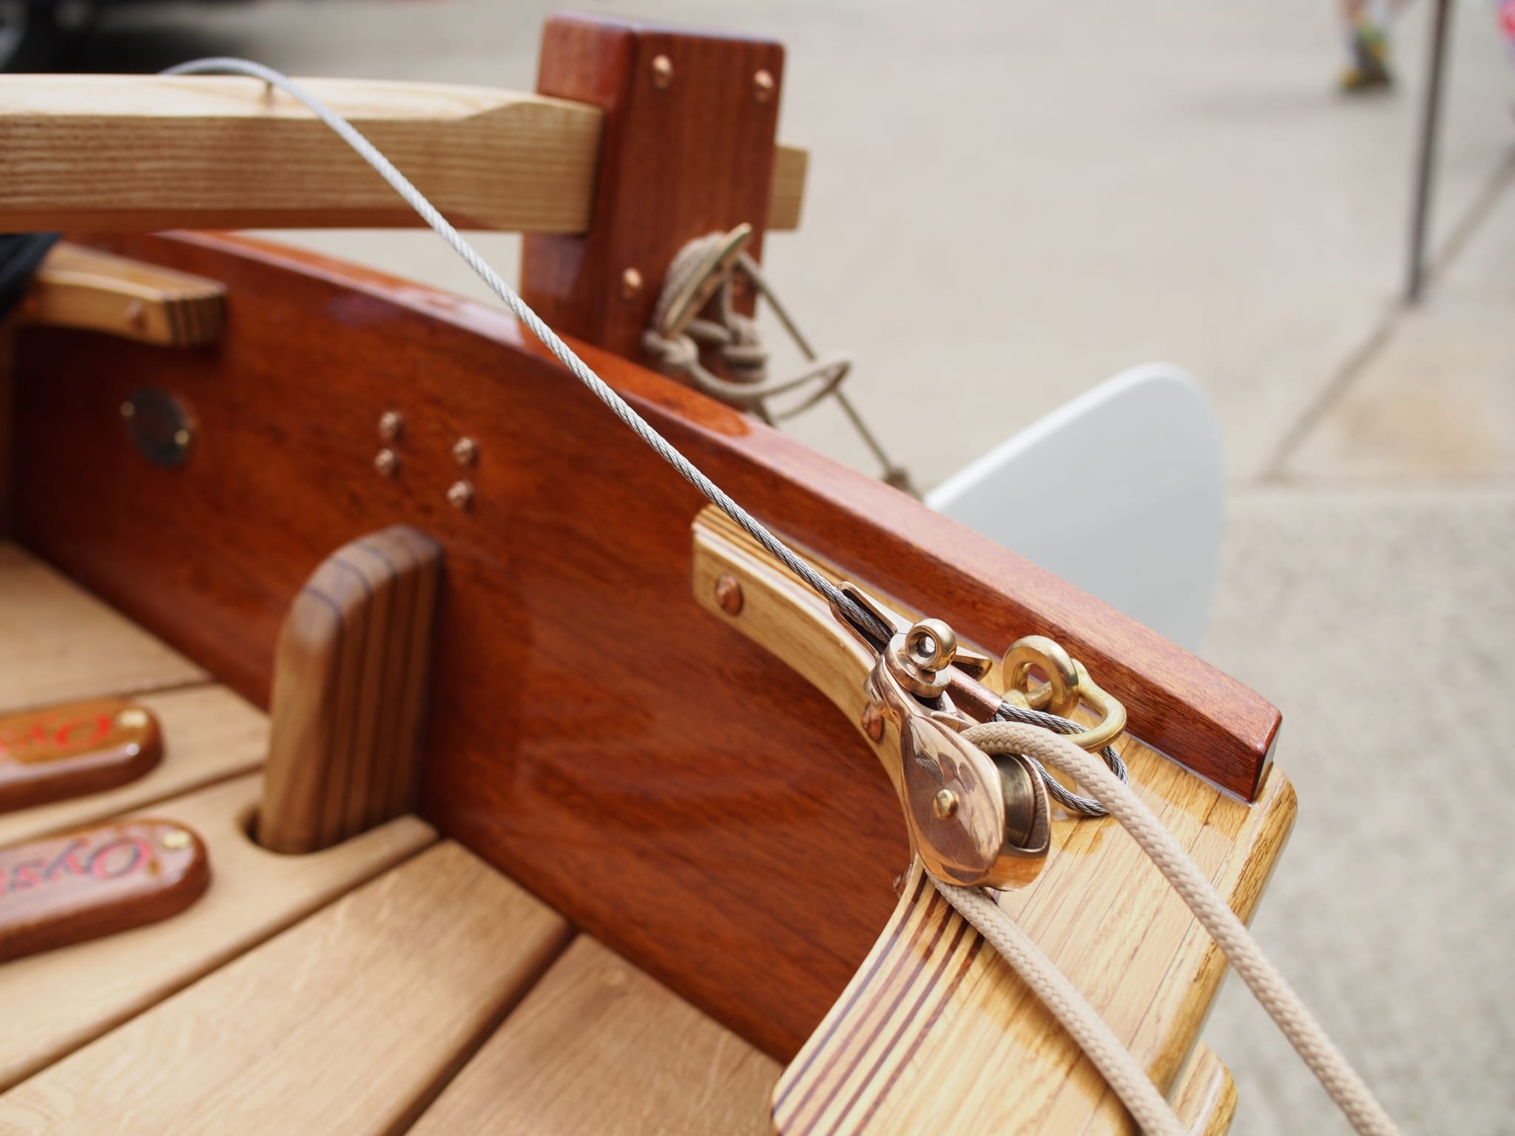
Laminated steamed veneers to make the knees, stem, breasthook and sternpost knee in the Everson 11

Slide 9
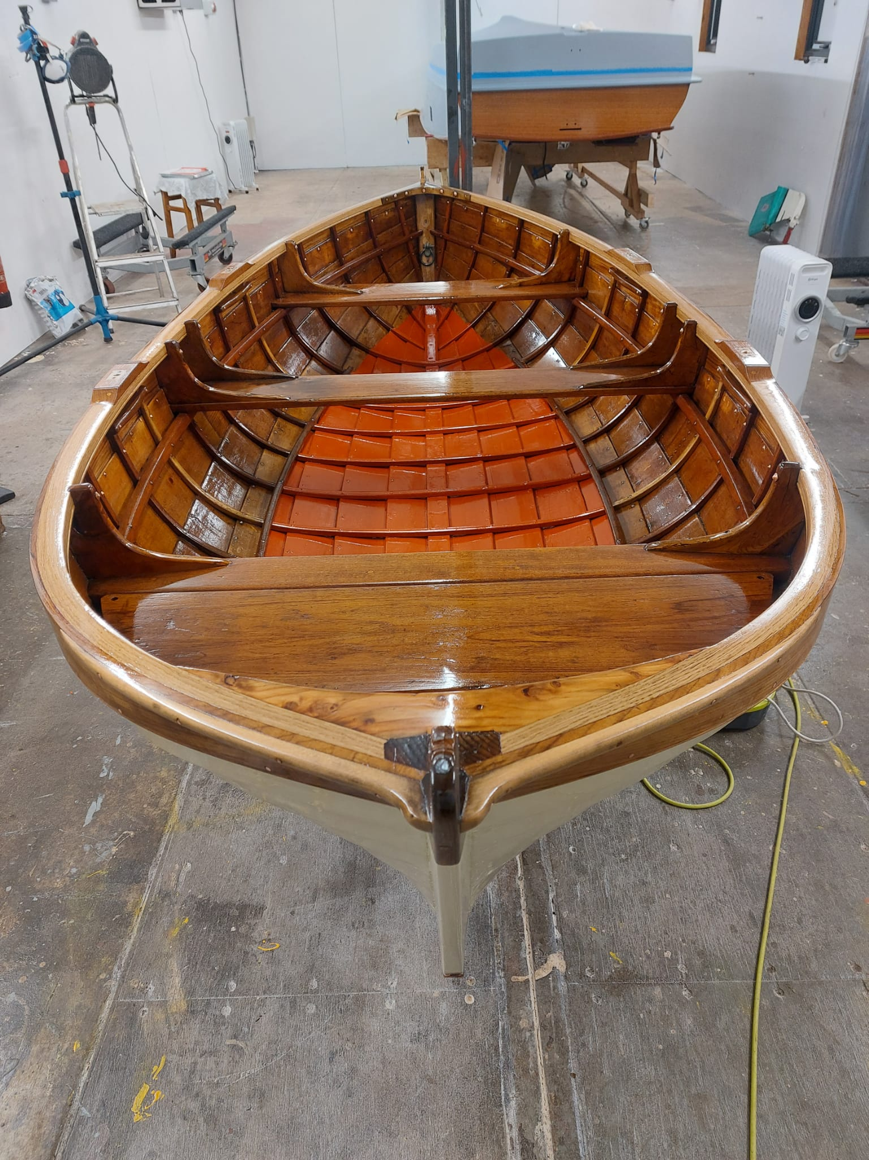
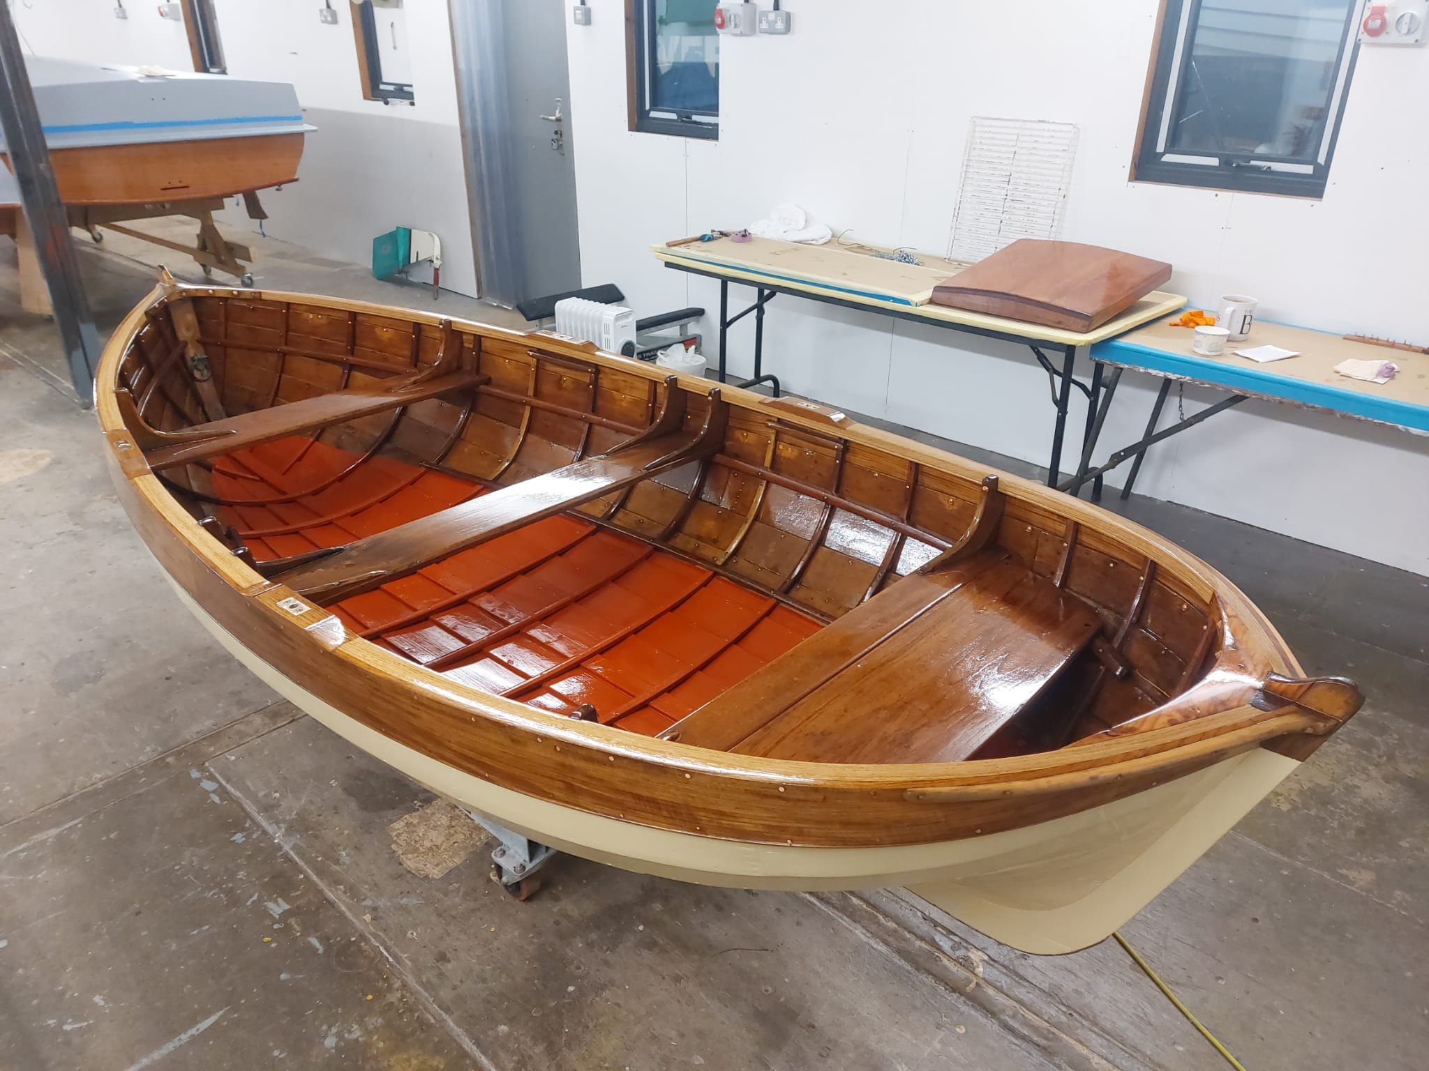
Loch Fyne dinghy with steambent teak shear planks

